Slide 1
Please Read
Background art, fonts, and the color palette have been formatted for you in the Slide Master.
The font for this presentation is Arial. Please use only this font.
Line-spacing for bullets has been set for you. There should not be a need to add an extra “carriage return” (Enter key) between bullets.
Read the “Helpful Hints” provided in the Presenter Notes of this slide (select “Show Presenter Notes” from the “View” menu).
Notes:
Helpful hints:
Please do not begin your presentation with a description of your company (unless you are presenting a case study), or of your CV. Your session facilitator will introduce you.
Your score matters! The score you receive at RSA Conference will weigh your future call for speakers submissions. Your high score this year will help your submission get accepted next year!
Don't put too many text slides in a row -- vary the visual input with graphs, graphics and photos.
If you have more than 4 or 5 bullets, it's better to add a second slide with the second part of the information — this also allows you to maintain a consistent type size.
Remember to review the abstract you submitted, to make sure that your session still reflects what the attendees are expecting.
For more suggestions, download the “Guidelines for Preparing your PowerPoint Presentation” file from the Speaker Resource Center.

Slide 2
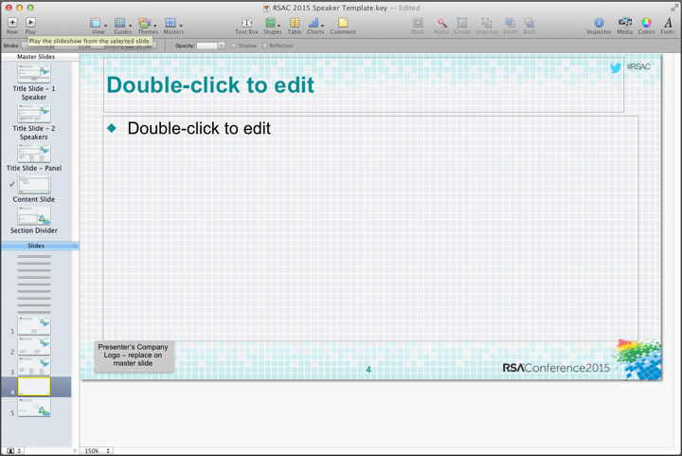
Using This Template
There are 5 pre-formatted slide layouts for you to use. These can be accessed by selecting Show Master Slides from the View menu

Slide 3
Using This Template
This template has been designed to allow you to insert your own logo in the lower left corner of the content slide.
To insert:
View > Show Master Slides
In the top left-hand window, click on the slide named “Content Slide.” (Important! Do not skip this step!)
Click on the placeholder box at lower left and delete it
Insert > Choose then browse to your logo art
Resize logo art as needed
Return to the regular slides to add your content

Slide 4
Chart colors default to the RSA Conference 2015 brand colors

Slide 5
Provide an “Apply” Slide – Part 1
Complete the “equation” for attendees:
Educate + Learn = Apply
Your Role as Instructor
Attendee Role as Student
How to Apply this in the office = Critical to justify attendance
Every presentation must contain an Apply slide!

Slide 6
Provide an “Apply” Slide – Part 2
Sessions focused primarily on people, process and technology issues (e.g., Data Security & Privacy, GRC, Identity, etc. sessions), should provide:
1 – 2 specific immediate actions for attendees to take as a result of your session (e.g., issues to identify in their own environment, other individuals to collaborate with, etc.)
2 – 5 specific actions that attendees could implement within 3 months of returning to the office
NOTE: all can include specific considerations necessary (e.g., type of OS, type of network topology, specific protocols impacted, organizational structure, processes, etc.) to implement specific actions

Slide 7
Provide an “Apply” Slide – Part 2 continued…
Sessions focused primarily on potential threats (e.g., Hackers & Threats sessions), should provide:
Specific information about the threat(s) that attendees can use to validate their organization’s exposure to the threat(s) discussed
Specific remediation actions for the threat(s) discussed

Slide 8
Provide an “Apply” Slide – Example: Apply What You Have Learned Today
Next week you should:
Identify critical database(s) within your organization
In the first three months following this presentation you should:
Understand who is accessing the database(s), from where and why
Define appropriate controls for the database
Within six months you should:
Select a security system which allows proactive policy to be set according to your organization’s needs
Drive an implementation project to protect all critical databases

Slide 9
Cookin' Up Metrics With Alex and David: A Recipe For Success!
DSP-T09
David Mortman
Alexander Hutton
Chief Security Architect, Dell @mortman
Society of Information Risk Analysts
(and I work for a SIFI bank)
@alexhutton

Slide 10
Agenda
Do some level setting
Introduction (How We All Got Here)
Part One - What’s A Useful Metric? Metrics, Measurement, Models, & Meaning
Part Two - Building Metrics With GQM (for fun and profit)
Part Three - Why Scorecards Suck (the value of visualization)
*

Slide 11
PART 1: INTRODUCTION

Slide 12
Who are we?
Our goal for you is….
What does your boss want out of this?
*

Slide 13

There is no “Secure”, only Securing…
*

Slide 14
INTRODUCTION

Slide 15
The current state of metrics in the industry...
*

Slide 16
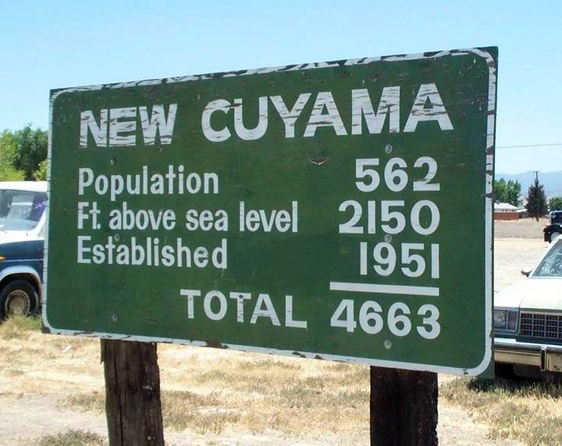

Slide 17
Just Kidding
8
8

Slide 18
Just Kidding - It’s Worse
8
8

Slide 19
WHY?
9
9

Slide 20

9
9

Slide 21
SECURITY!
9
9

Slide 22

Why? #2 - Aggregate Meaning
*

Slide 23


Why? #2 - Aggregate Meaning
*

Slide 24
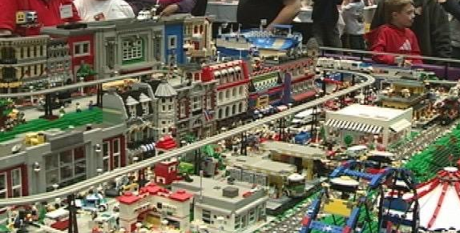
Why? #2 - Aggregate Meaning
*

Slide 25

Why? #2 - Aggregate Meaning
*

Slide 26

Why? #2 - Aggregate Meaning
*

Slide 27
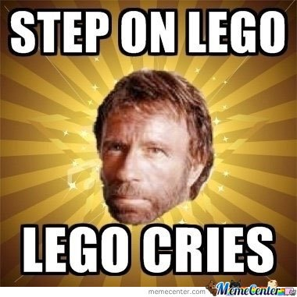
Why? #2 - Aggregate Meaning
*

Slide 28
Why? #2 - Aggregate Meaning
*

Slide 29
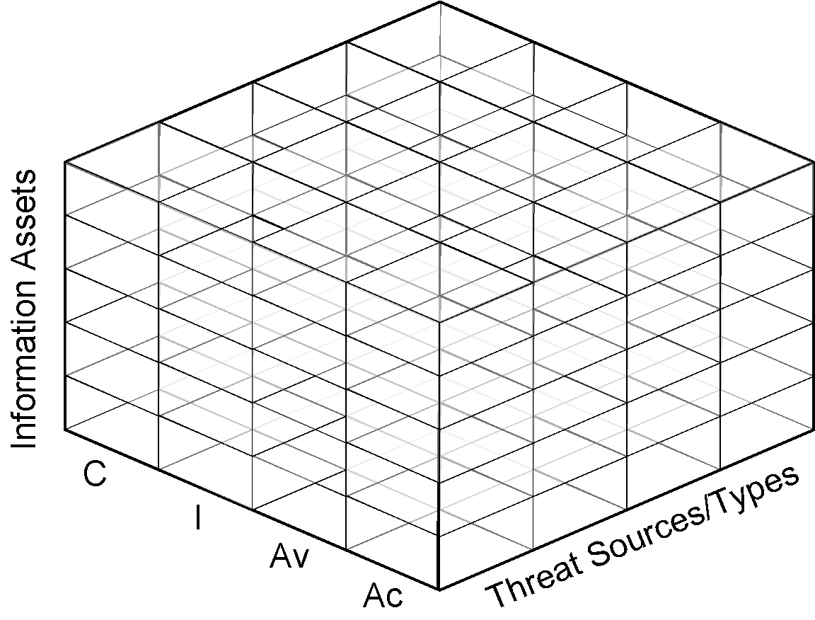
Framework
∑
=
∫
√
Models
Data
∩

Slide 30
PART 2: WHAT MAKES A USEFUL METRIC?

Slide 31
What is a metric?
*

Slide 32
What is a metric?
Control Effectiveness is “medium”
- arguably?
*

Slide 33
What is a metric?
We have 53 “medium” control effectiveness ratings
- now we’re getting somewhere.
*

Slide 34
What is a metric?
We have 53 “medium” control effectiveness ratings, which represents 1/3 of our overall ratings, the other 2/3 are all “strong”
- now we’ve got a story.
*

Slide 35
What is a metric?
It would be easy for me to tell you that a metric is “quantitative information” and leave it at that.
In fact most folks would...
*

Slide 36
What is a metric?
A metric is quantitative information that (helps) tells a story.
*

Slide 37
What is a metric?
State of Nature
State of Knowledge
State of Wisdom
METRIC
MODEL
DECISION
*

Slide 38
What is a metric?
A metric is quantitative information that (helps) tells a story.
That story is designed to cause a decision (action/no action).
*

Slide 39
Lesson 4 - What is a metric?
That story can either be obvious or part of a larger picture.
*

Slide 40

Things to Make Metrics About
Only four “types” of information
asset information
impact information
risk
threat information
controls information
1/28/2015
IANS Research | Client & IANS Confidential.
Notes:
Moreso than math, moreso than compliance, a risk “expert” needs to have a strong amount of knowledge in four key areas: Threat, Controls, Assets, Impacts. This diagram is useful because it helps us visualize that, if we’re going to talk about risk, we need to be talking about some *stuff* from EACH circle. And we’re only talking about risk when something from each circle is considered.
We can talk about controls vs. threat actions for example, but until we understand how that interaction affects our operating environment - we may be having a good and useful conversation, but it’s not yet a risk conversation.

Slide 41
What matters most to your organization?
11
11

Slide 42
Money & Time
12
12

Slide 43
(The most important metrics = money & time)
Anytime you can report a metric using money or time as a part of the equation, you win.
This is why the best risk statements are Frequency x Impact
Even if you can allude to money or time, so that it’s what the executive is thinking about in the back of their head - it’s a win.
*

Slide 44
The purpose of your metrics/risk program?
Create time or money
Save time or money
asset information
impact information
risk
threat information
controls information
*

Slide 45
Why is a security metrics program so darn important, but so darn tough?
*

Slide 46
Security is an expense, like a car. It gets you where you are going, but costs a bunch. CEO’s, CFO’s - they typically don’t like expenses. Thus, metrics are important.
16
16

Slide 47
Unlike other expenses, it is difficult to quantify how much security contributes to revenue. Security success is probabilistic. (as is security failure until it happens)
17
17

Slide 48
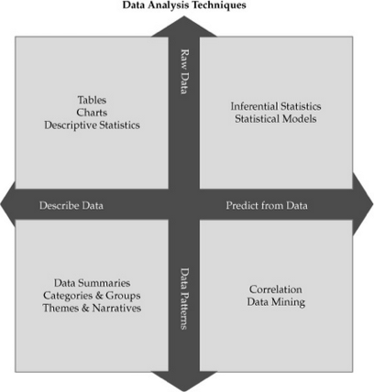
From Lance Hayden’s excellent book, IT Security Metrics
*

Slide 49
Dealing with the Vagaries & Giving up My Quest for the Golden Risk Ratio
60
60

Slide 50
Qualitative is Ok
61
61

Slide 51
Subjective is Ok
62
62

Slide 52

Subjective & Objective are not binary, they are a spectrum
In creating meaning for your audience, your goal is to get as meaningful as possible, not as objective as possible.
Objectivity is a function of the model and the ability to measure.
63

Slide 53
The ultimate tool: GQM
92
92

Slide 54

Goal, Question, Metric
Conceptual level (goal)
goals defined for an object for a variety of reasons, with respect to various models, from various points of view.
Operational level (question)
questions are used to define models of the object of study and then focuses on that object to characterize the assessment or achievement of a specific goal.
Quantitative level (metric)
metrics, based on the models, is associated with every question in order to answer it in a measurable way.
Victor Basili

Slide 55
GQM For Fun & Profit
Goals establish
what we want to accomplish.
Goal 1
Goal 2
Questions help us understand how to meet the goal. They address context.
Q1 Q2 Q3 Q4 Q5
Metrics identify the measurements that are needed to answer the questions.
M1 M2 M3 M4 M5 M6 M7

Slide 56
GQM For Fun & Profit
Execution
Goal 1
Goal 2
Models
Q1 Q2 Q3 Q4 Q5
Data
M1 M2 M3 M4 M5 M6 M7

Slide 57
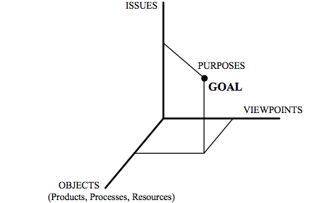
Regarding your Goals
1. Issue 2. Object (process) 3. Viewpoint 4. Purpose
97

Slide 58
Regarding your Goals
1. Issue | Timeliness 2. Object (process) | Change request processing 3. Viewpoint | Project manager 4. Purpose | Improve
97

Slide 59
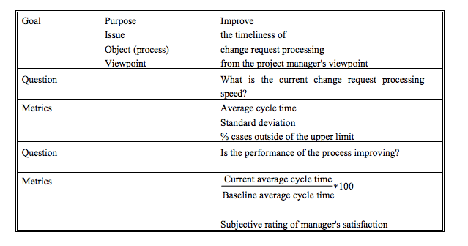
An Example
98

Slide 60
AN EXAMPLE - PATCH MANAGEMENT GQM SCORECARD

Slide 61
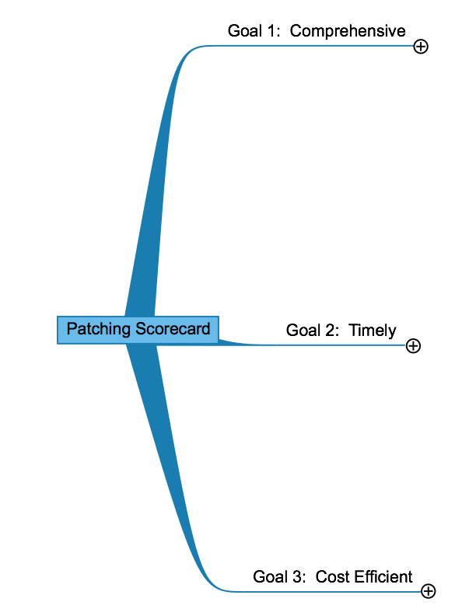

Slide 62
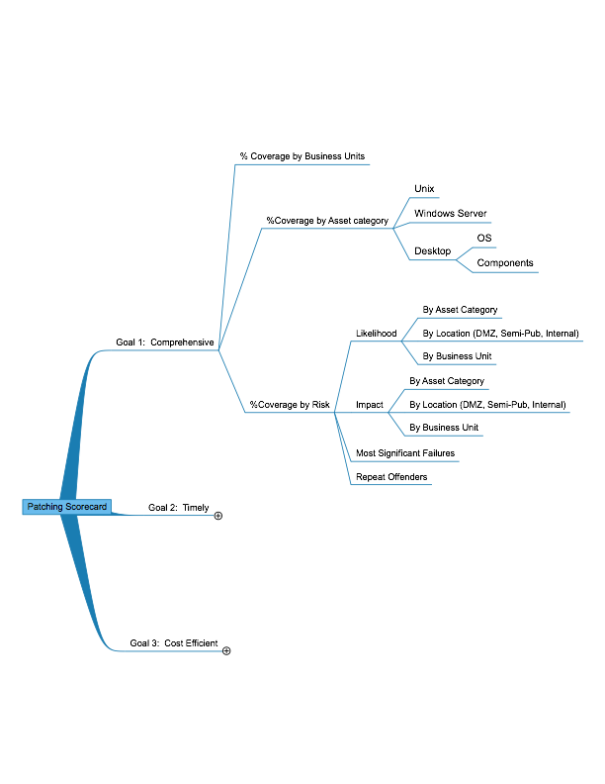

Slide 63
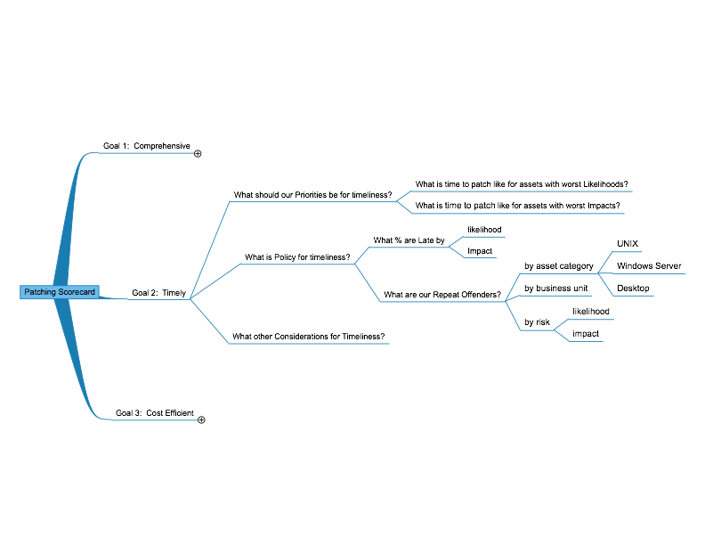

Slide 64
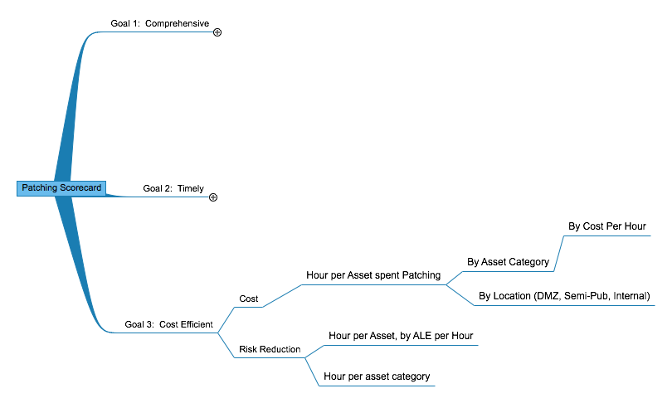

Slide 65
The Measured CISO: Metrics & The ISMS

Slide 66
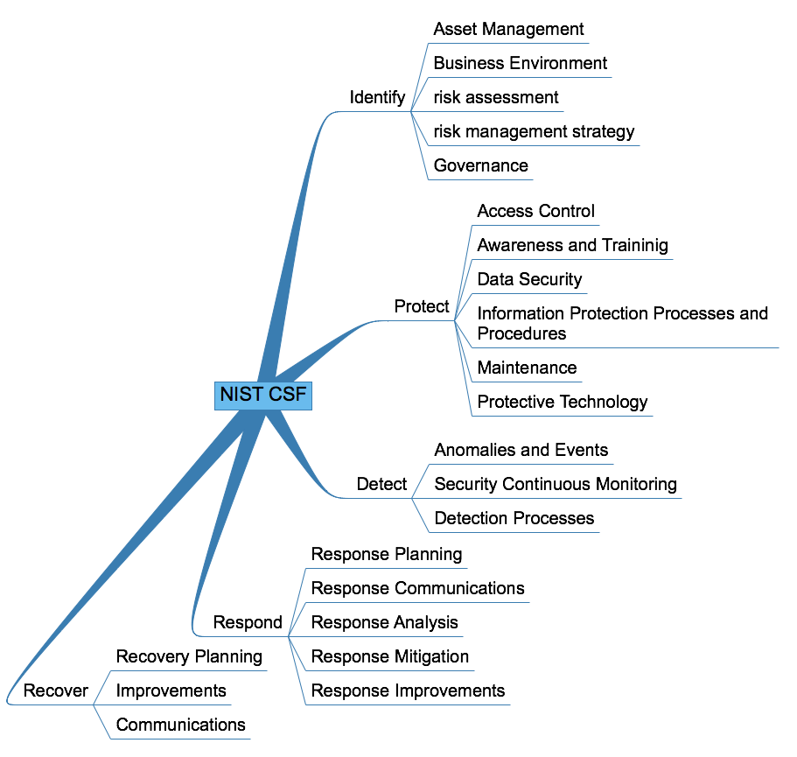

Slide 67


Slide 69
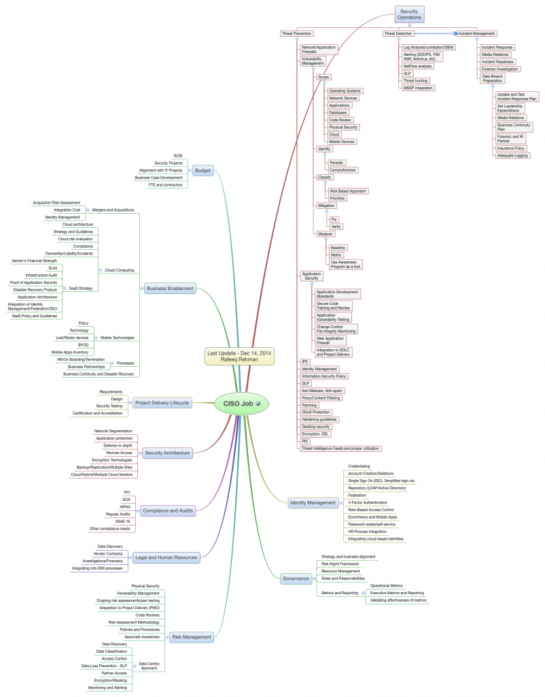
Work of Rafeeq Rehman: http://rafeeqrehman.com/2014/12/14/latest-update-to-ciso-responsibilities-mind-map/

Slide 70
Work of Rafeeq Rehman: http://rafeeqrehman.com/2014/12/14/latest-update-to-ciso-responsibilities-mind-map/
Patching LIVES Here

Slide 71
Work of Rafeeq Rehman: http://rafeeqrehman.com/2014/12/14/latest-update-to-ciso-responsibilities-mind-map/

Slide 72
A Note On GQM
Works really well in conjunction with a Balanced Scorecard
Can be used well with COBIT’s concepts of outcome measures and performance indicators
More importantly, it can work in your environment with, say, VERIS categories.
Speaker’s Title Company / Organization @Twitter handle
99

Slide 73
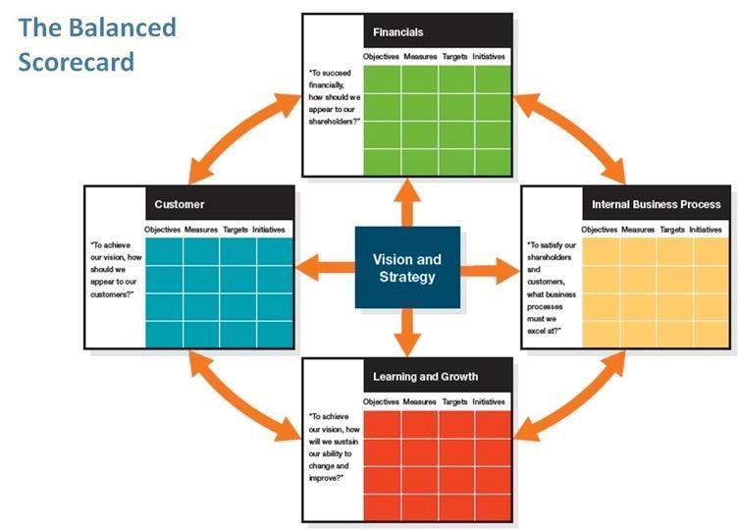
Scorecarding
100

Slide 74

Balanced Scorecard for Security
Impact
Asset
Controls
Threat
102

Slide 75
Balanced Scorecard for IT GRC
IT Operations
Applications development
- Project management
- System development life cycle
Production support
- Production control & operation
- job scheduling
System backups
Technical architecture
Network design management & operation
Help desk
Information security Governance
BCP/DR
Contract administration & vendor management
IT Strategic Planning & Alignment
IT Steering Committee / Priority Process
IT Strategy & Architectural standards
IT Project Tracking
Support for strategic enterprise initiatives
IT Control
Information Management Policies
- Corporate
- IT departmental
Standards - CoBIT, ITIL, ISO, etc.
Practices & procedures
System documentation management
Quality assurance
Regulatory compliance
- FFIEC Requirements
- Escalation procedures
- Disclosure procedures
Behaviors
IT Financials
IT Operating budget
IT Capital budget
IT Asset management
IT Contract management
IT Resource allocation and planning
53
53

Slide 76
Balanced Scorecard for Risk Management
Compliance
Behaviors
Governance
Risk
Operations
103

Slide 77
Framework
∑
=
∫
√
Models
Data
∩

Slide 78
Scorecards for profit & Data Visualization
54

Slide 79
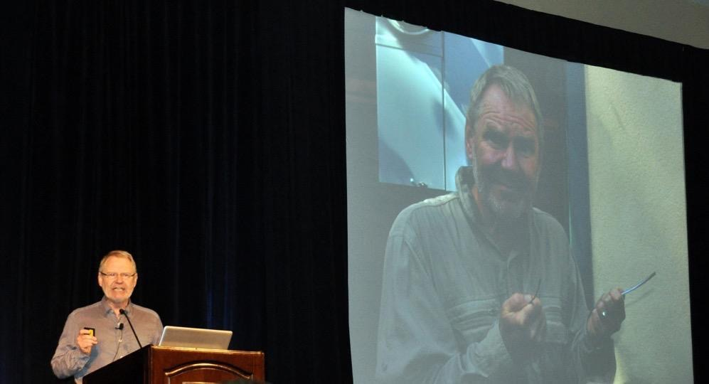

Stephen Few.
Buy everything he makes. Do everything he says.
55
55

Slide 80
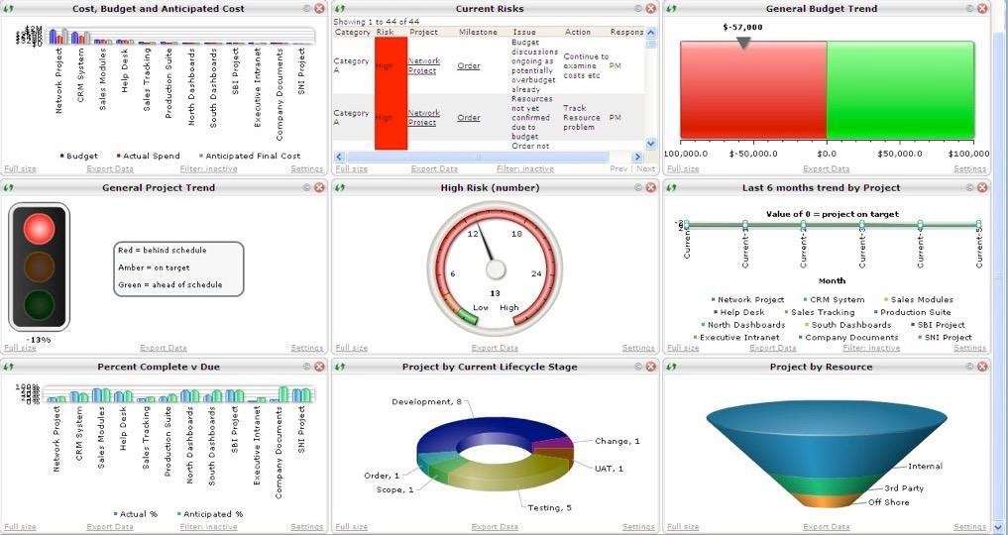
56
56

Slide 81
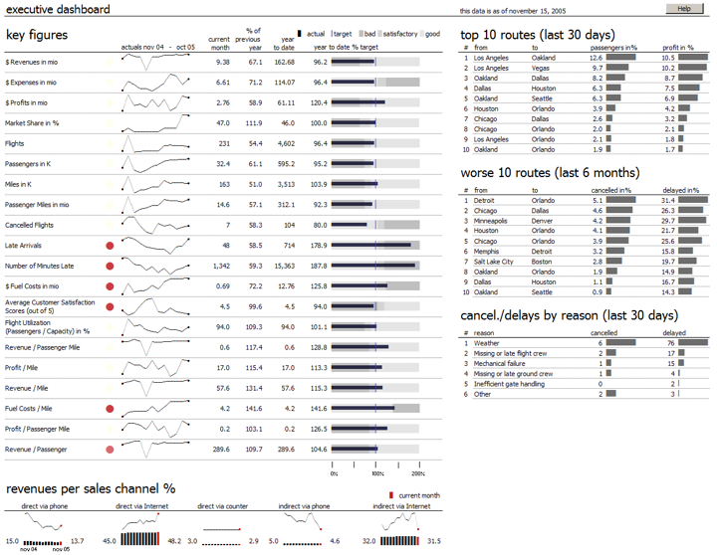

Slide 82
Dave & Alex Metric Cooking Tips
Every Pixel Has A Purpose
Cute is evil
Appreciate the Purpose of White Space
Colors aren’t always as necessary as you think they are
But when they are, use them wisely (treat them like ammo)
Consistency is Key
Rationalize Copiously
When you think you’re done, walk away, come back, start removing things
When in Doubt, Do What Stephen Few Would Do
If It Needs Explanation, it’s Not Right
58

